Slide 1
Waiting Time Management
Chapter 14

Slide 2
Why??
Pervasiveness of Problem
  Retail staffing
  Back-office staffing
  Example:
    Call Centers (US economy)
    number: 20,000 – 350,000
    people: 4 million – 6.5 million
    expenses: $100B - $300B (50-75% labor)

Slide 3
Why?
Importance
  THE customer service standard
  “Halo” “Pitchfork” effect
Lack of Managerial Intuition
  Difficulty - Linear thinkers need not apply

Slide 4
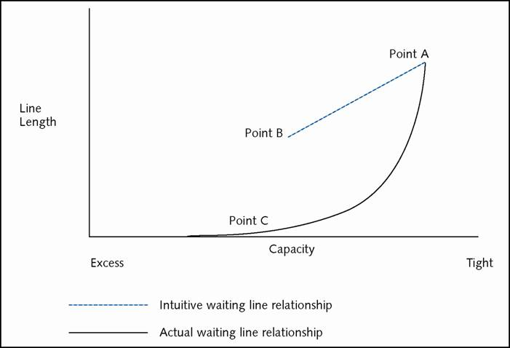
Waiting Line Math

Slide 5
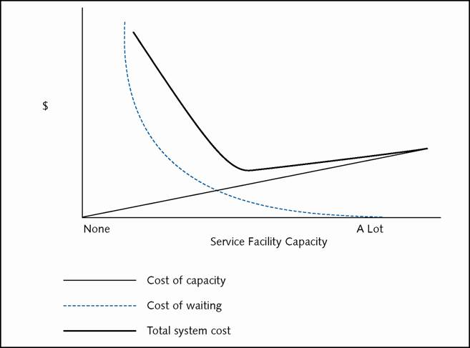
Economics of Waiting Lines

Slide 6
CASE STUDY (fictional):
FeeHappy Savings & Loan
Target Market:
  Professionals, High net worth individuals, Small/medium businesses
Operational Focus: High Service
Question to Answer:
  Given work load, how many reps?

Slide 7
Work Content at FeeHappy
How many customer service reps are needed?
  average work content per customer x
  average number of customers/day = average work per day

Slide 8
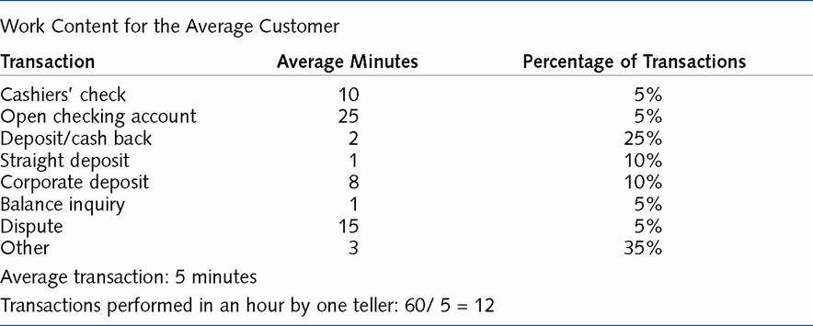
Work Content at FeeHappy

Slide 9
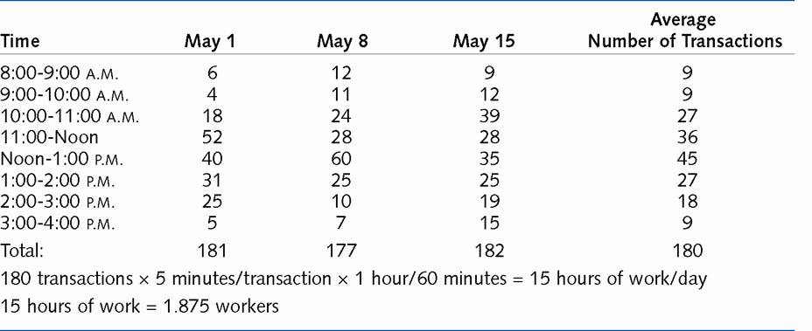
Customer Arrivals at FeeHappy

Slide 10
Customer Arrivals at FeeHappy
180 transactions x 5 minutes/transaction x 1 hour/60 minutes = 15 hours of work/day
15 hours of work = 1.875 workers (2 workers)

Slide 11
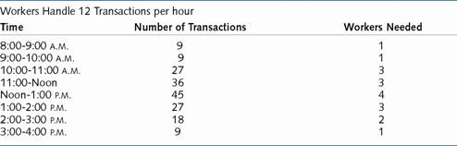
Effective of Variance: Variance of Customer Arrivals During the Day

Slide 12
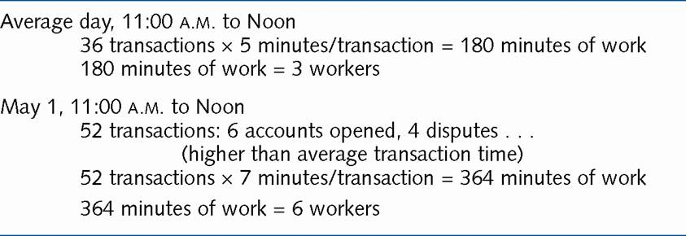
Effect of Variance: Transaction Times and Number of Customers

Slide 13
A Tale of Two Tellers:
One Teller Scenario
Arrival Transaction Waiting Leaves
Time Transaction Time Time Teller
08:00 Balance Inquiry 1 0 8:01
08:04 Deposit/cash back 2 0 8:06
08:08 Open account 25 0 8:33
08:19 Cashier’s check 10 14 8:43
08:25 Other 3 18 8:46
08:29 Deposit/cash back 2 17 8:48
08:46 Straight deposit 1 2 8:49
08:52 Other 3 0 8:55
08:54 Other 3 1 8:58
Total 50 52

Slide 14
A Tale of Two Tellers:
Two Teller Scenario
Arrival Transaction Waiting Leaves Leaves
Time Transaction Time Time Teller 1 Teller 2
08:00 Balance Inquiry 1 0 8:01
08:04 Deposit/cash back 2 0 8:06
08:08 Open account 25 0 8:33
08:19 Cashier’s check 10 0 8:29
08:25 Other 3 4 8:32
08:29 Deposit/cash back 2 3 8:34
08:46 Straight deposit 1 0 8:47
08:52 Other 3 0 8:55
08:54 Other 3 0 8:57
Total 50 7

Slide 15
Waiting Line Math
λ (Arrival Rate - People/hour)
μ (Service Rate - People/hour)
Average time in line
= arrival rate/[service rate(service rate-arrival rate)]
= λ /[μ(μ-λ)]
1/λ = Average Time Between Arrivals = minutes per person
1/μ = Average Service Time = minutes per person

Slide 16
Waiting Line Math
ρ = Utilization = λ/μ
n_{L} = Average Number in Line = λ2/[μ(μ-λ)]
n_{S} = Average Number in the System = λ/(μ-λ)
t_{L} = Average Time in Line = λ/[μ(μ-λ)]
t_{S} = Average Time in the System = 1/(μ-λ)
P_{n} = Probability of n People in the System
= (1-λ/μ)(λ/μ)n

Slide 17
Waiting Line Math
Basics:
  if λ (Arrival Rate) > μ (Service Rate) then people are arriving faster than they can be served
  infinite line if steady state condition.
  if λ < μ, but close, big lines can still form

Slide 18
Customer Arrivals at FeeHappy
FeeHappy 12:00 - 13:00
λ (Arrival Rate) = 45
μ (Service Rate) = 12
  Server 4x as fast: Time = 45/[48(48-45)]=19 minutes Utilization = 94%
  Server 5x as fast: Time = 3 minutes
  Utilization = 75%
  Server 6x as fast:Time = 1.4 minutes
  Utilization = 63%

Slide 19
Customer Service and Waiting Lines
Work content of an average day: 15 hours
  If inventory allowed, 1.875 workers
Service level of 1.5 minute average wait: 6 workers
  Worker utilization: 31%
Scheduling complications??

Slide 20
Multiple Servers
Two servers sharing same line:
  Arrival rate = 40/hour
  Service rate/server = 25/hour
  Number in line = 2.92
Two servers with separate lines:
  Arrival rate for both = 20/hour;
  Service rate = 25/hour
  Number in line = 3.20
    Arrival rate for (1)= 24/hour; for (2) = 16/hour
    Service rate = 25/hour
    Number in line = (1) >18 (2) 1.2

Slide 21
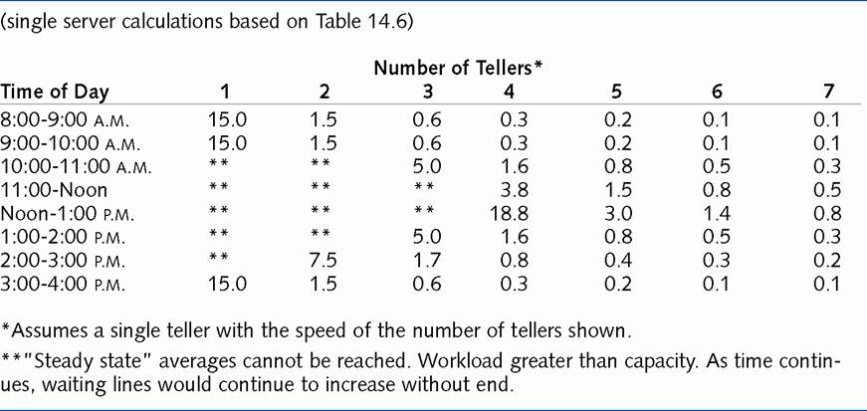
Average Minutes Waiting in Line at FeeHappy

Slide 22
Centralization of Waiting Lines
Example:
  Telephone call center
    Average handle time per call = 3 minutes
    Service level desired: Average seconds to answer = 10
    Call volume = 4,000 calls per hour
Call Volume Workload hours Staff Required Total Staff
Facilities per Facility per Facility per Facility Required
20 200 10 14 280
8 500 25 30 240
4 1,000 50 56 224
2 2,000 100 107 214
1 4,000 200 209 209

Slide 23
Solutions
Recognize speed of service/efficiency trade-off
Reduce randomness of arrivals
  appointment systems
  pricing incentives
Reduce randomness of service time
System changes
  pooling resources
  reducing handoffs

Slide 24
Psychology of Queuing
"Perception is Essence"
Perception more important than reality
Unoccupied time feels longer than occupied time
  Operational Action: distract and entertain with related or unrelated activity
Preprocess waits feel longer than in-process waits

Slide 25
Psychology of Queuing
Anxiety makes waits feel longer
  Operational Action: communicate as soon as possible, get customers "in-process"
Uncertain waits feel longer than known waits
Unexplained waits feel longer
  Operational Action: communicate frequently
Unfair waits feel longer
  Operational Action: physically segment different markets

Slide 26
Chapter Summary
The waiting line problem is important
  It often forms the basis of service quality judgement
  Not intuitive – difficult for managers to understand
Appropriately setting expectations and can be just as effective as adding expensive capacity
Waiting line math can be very complex
  Simulation can build intuition and provide answers to managerial questions

